Slide 1
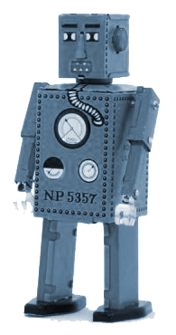
Automation Tools
Notes:
Today we’re going to talk about the automation tools that are transforming the way we do synthetic biology.

Slide 2
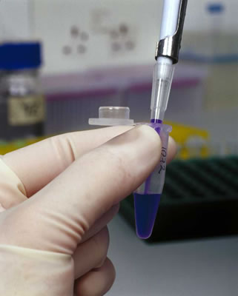
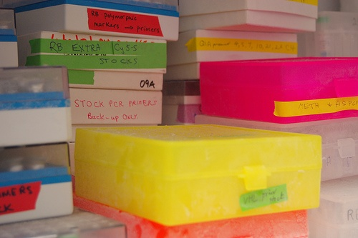
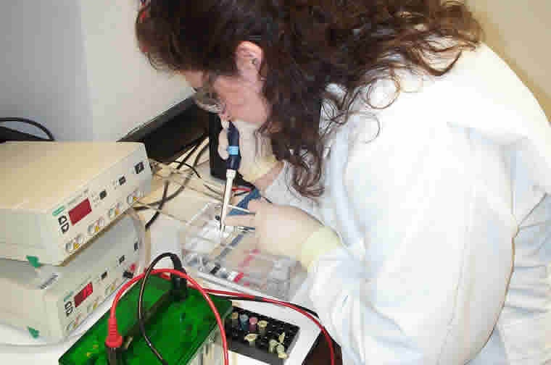
Synthetic Biology Today
Notes:
As of 2013, most of synthetic biology still involves the sorts of manual procedures that you have learned in this course. You make DNAs in small sets giving tender loving care to each construct, you run manually-poured gels, and you store things in an ad-hoc manner in the freezer.

Slide 3
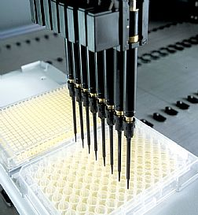
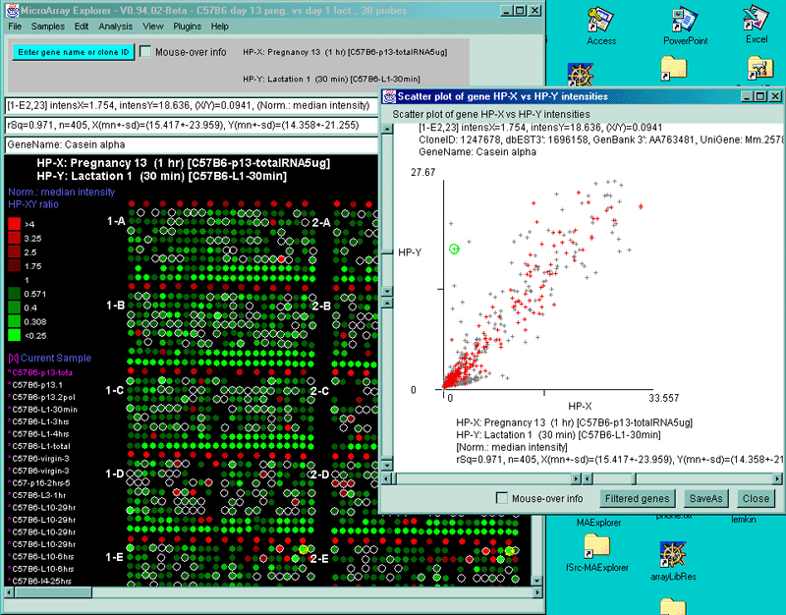
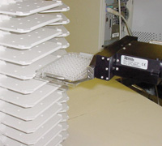
Automated Synthetic Biology
Notes:
There is a great deal of effort underway to change the way we do genetic engineering to make it much easier and quicker to perform. The use of liquid handling robotics is already extensive in the larger biotech companies and government labs, and these instruments are being incorporated into the academic wetlab as well. This is accompanied by suites of software tools that manage the wetlab experiments allowing them to scale, but much of the design process is also being automated in the form of design and verification tools.

Slide 4
Why automate?
Reproducibility
Miniaturization
Increased throughput
Reduce labor costs
Allows higher levels of abstraction
Notes:
There are many good reasons to automate a wetlab experiment. When you perform complex manual tasks as an individual, there are issues with reproducibility caused by subtle differences in how each user conducts the experiment. When a machine does thing, it comes out more similar run-to-run, and more importantly, the run-to-run variability can be measured and this uncertainty factored into the experimental design.
Automation and multiplexing also enable the miniaturization of experiments. When you do everything with a pipette in eppendorfs, you use a large amount of reagent. When a robot does it, the reactions can be reduced to tiny volumes, even as small as 1nL, thereby saving space and reagent costs.
Where automation is most useful is in increasing throughput. You all would probably have no problem doing 10 cloning experiments in parallel. But what if I gave you 100 or 1000 to do? It is in the scaling of what you normally do in the lab to much higher volume that you encounter the need for robotics and automation.
Though automation often requires high capital investments (robots are expensive) and high consumable costs (robot tips and barcoded tubes cost more than your universal tips and eppendorfs), there is often a labor cost savings with automation. Most of the price reductions in gene synthesis over the past ten years have been the result of incorporating automation into the DNA fabrication pipelines at companies.
Most usefully, automation enables higher levels of abstraction. Today if I ask you to design a cloning experiment for a part, you will follow the sorts of thought processes that you learned in your tutorials, and you will expend a large amount of time and energy into making that one thing. If you instead use automated scripts for the design and robots to do the fabrication, you only need to provide a specification for the part and the rest happens automagically. So, you spend less time dealing with issues of fabrication and low-level design and can instead focus on the more interesting aspects of the experiment.

Slide 5
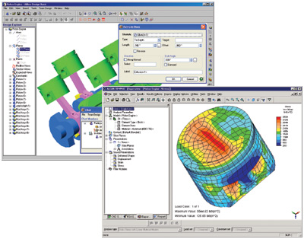
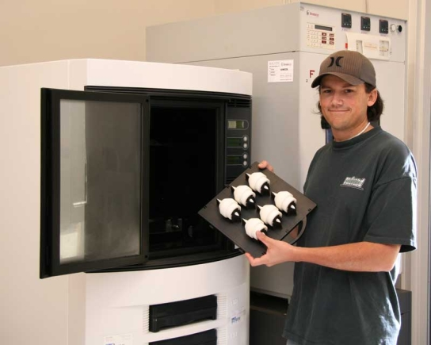
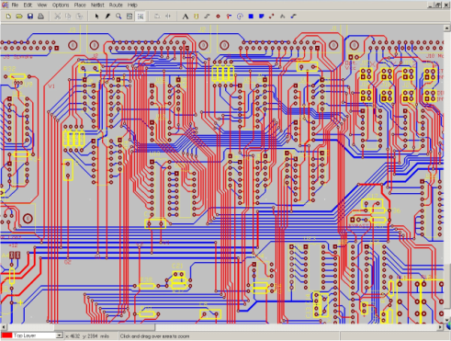
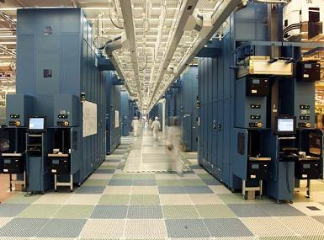
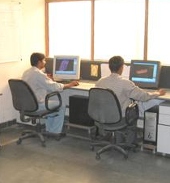
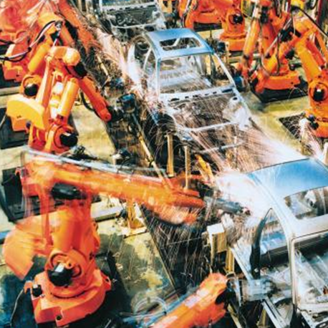
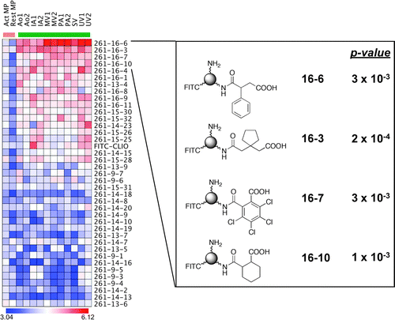
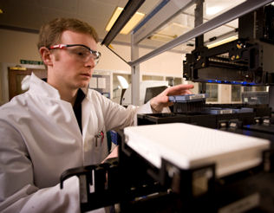
Automation in other fields
Mechanical Engineering
Electrical Engineering
Automobile Manufacturing
Drug Discovery
Notes:
Automation has become fully integrated into most other fields of engineering and even in the biological space of drug discovery. The sorts of tools are generally referred to as CAD (computer aided design) or CAM (computer aided manufacturing). Both CAD and CAM now have counterparts in genetic engineering. CAM has been demonstrated with the Gibson, GoldenGate, BioBrick, and PCA fabrication chemistries, to name just a few. Though much of our fabrication is still done by hand, the only reason for this is that fabrication as a service has only thus far been provided for total gene synthesis. Efforts are underway to develop services for the assembly methods as a service, and these should be existant by 2015. What this means is that the painful part of wetlab synthetic biology is disappearing, and software tools are playing a more prominent role in the day-to-day implementation of projects.

Slide 6
Robotics
Notes:
Liquid handling robots and related equipment have been around for several decades now. Like all fields, the tools for doing biology are under continuous development, but the robotics space for automating wetlab experiments isn’t new. It’s used extensively in the pharmaceutical industry, but also in high-throughput screening based companies and core facilities. Let’s take a look at some of the equipment and what they do.

Slide 7
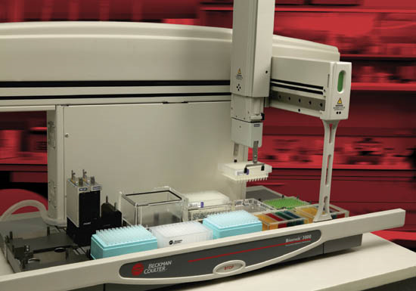
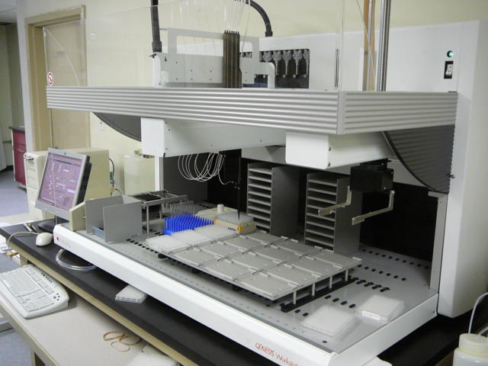
Tip-Based Liquid Transfer
Notes:
The most basic type of automation equipment is a liquid handler. A conventional liquid handler does exactly what you would do by hand using a single-channel or multi-channel pipettman. They employ special tips that are incompatible with LTS or universal pipettman, but other than how they attach to the machine, they serve the same purpose as they do with manual liquid handling. Essentially the robot is a 4-dimensional CNC machine: you can move horizontally through the x and y dimensions of the deck, up or down, and you can press the piston within the pipette head to aspirate or dispense liquid. You can control the movements of the robots across these 4 dimensions however you wish, but the instruments all come with software that wraps sequences of movements into commonly-used operations such as aspiration, dispensing, and mixing.
<click>
Different models of liquid handlers differ in terms of the size of the workspace (which is how many plates can be positioned on the deck at one time), whether they also include the means of moving plates within the deck (usually referred to as a gripper tool), how many pipette heads are accessible, and the size and volume of the pipette head. You can get single-channel pipette heads that match the size range of manual ones – from single microliter to milliliter volumes. You can also get multi-channel heads that deliver in units of 8, 96, or 384 tips at a time. Because of the large number of tips involved, the slightly higher cost of these tips, and the need for some monitoring and setup by a technician, using a liquid handling instrument often gets quite pricey. This is not something to consider using unless you intend to process at least a few thousand samples for most applications. There is also a significant capital investment in robotics. There is a saying that the cost of this equipment runs by weight, with a pricetag of around $1000 per kilogram of equipment, so these instruments run in the 10’s to 100’s of thoursands of dollars.

Slide 8
Acoustic Probe Liquid Transfer
Notes:
The cost of consumables and the desire for faster liquid transfers has led to the development of other methods that do not employ tips. The most recent of these technologies are acoustic probe liquid handlers that use sound waves to move tiny droplets of liquid. These typically transfer liquid in the nanoliter scale, and larger volumes can be moved by sending many smaller-volume droplets. Operationally, the acoustic liquid handler is a 2-dimensional CNC machine with an acoustic probe head. That head is position below the well of sample plate, and the emission of sound waves causes the droplets to jet from the plate. If another plate is positioned to receive these droplets you can jet the liquid into a recipient well. So, basically, this instrument holds two plates face-to-face, it aligns the plates such that the wells being operated on are aligned, and then it jets liquid from one well to the other. The analogous operation with a conventional liquid handler would be to use a single-channel pipet head to aspirate liquid from one well of one plate and dispense it in another well of another plate. This operation is generally referred to as ‘cherry picking’. The advantages of acoustics are the minimization of reagent volumes, the speed of the transfer process (it’s super fast), and the ability to dispense liquid to non-plate surfaces such as the surface of a silicon chip. The disadvantages are the cost, the newness of the technology, and some operational sensitivity to samples of certain composition—some solvents won’t work in it.

Slide 9
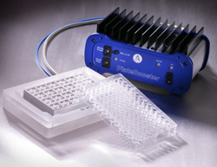
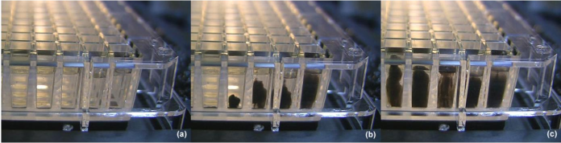
Acoustic Mixers
Notes:
An acoustic probe also lacks the ability to mix samples – it just transfers liquid. Other acoustic-based instruments exist to handle mixing. Here is an example of a device that uses sound waves beneath a plate to cause convection in the wells of a sample to achieve mixing. The images show the movement of magnetic particles that on the left have settled to the bottom of the plate.

Slide 10
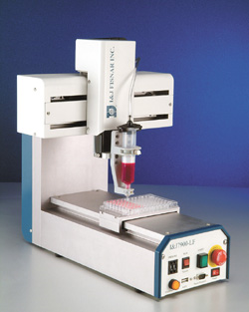
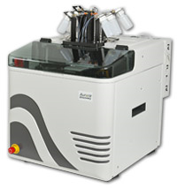
Dispensing Robots
Notes:
Thus far, the instruments we’ve discussed all move liquid from plates to other plates. Though some do this the entire plate at one time, these technologies all enable the cherry-picking operation in which one sample at a time is moved to an arbitrary other position of another plate. So, it allows NxN transfers of liquid. Another type of instrument, called a dispenser, does NxM transfers where M refers to a static set of reservoirs. This instrument has an m of 1: it holds a large reservoir of liquid in one syringe, and it pushes the plunger to emit liquid. This is a 3-dimensional CNC machine – you can move the syringe left and right to direct the flow of liquid to a particular well of the plate, and you can control the depth of the plunger. Another common mechanism is to have a large bottle of liquid under positive pressure with tube coming out that is attached to a dispensing head. By controlling the opening and closing of the valve in the dispensing head, the flow of liquid is turned on and off. These instruments often look much like this one in the sense that they have 2D movement of the plate below the dispensing head. An even simpler instrument has just 1 dimension of movement and an 8-channel dispensing head to deliver liquid to one row of a plate at a time. Even simpler ones, such as a plate washer (which we’ll come back to), dispense liquid to the entire plate simultaneously.
<Click>
More sophisticated dispensers are capable of delivering nanoliter volumes of liquid through the use of small piezoelectric valves that control the flow of liquid through channels. In this variant from Beckman called the BioRAPTR , has 4 reservoir channels in the pipetting head and 2 dimensional movement of the plate. They can put any amount of any of the 4 liquids into each well of a 1536-well plate in around 30 seconds.

Slide 11
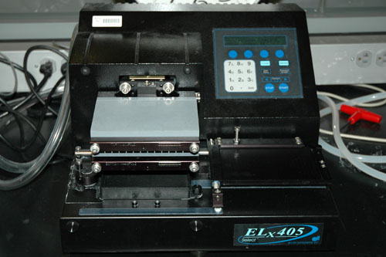
Plate Washers
Notes:
The plate washer is an older piece of equipement like the conventional liquid handler. They typically cost a few thousand dollars and are fairly common even in academic labs. Principally they are used for ELISA assays. You place your 96 or 384 well plate under its 96-pin dispensing and aspirating head. It can slurp the liquid out of all the wells in the plate and send it to a waste container, and it can spray liquid from a reservoir into the plate. In ELISA, having reproducible washes between the steps of the protocol is often essential for consistent data. Doing it with a manual multichannel pipetman with a steady hand often is sufficient, but a plate washer can handle these operations more reliably. This is something I have in my lab and would recommend having if you ever intend to do ELISA, even for a single-plate experiment.

Slide 12
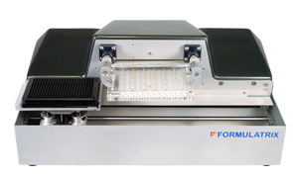
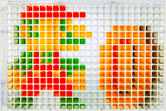
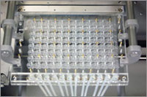
Microfluidic Liquid Handling
Notes:
Other tip-free methods of liquid handling can be done by microfluidic methods. Much like the BioRAPTER, this microfluidic liquid handler can dispense the liquid from multiple channels of sample into each well at any volume of 384-well or higher density plates.

Slide 13
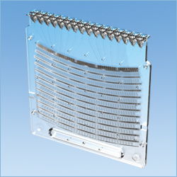
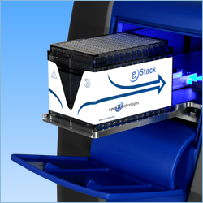
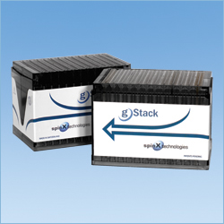
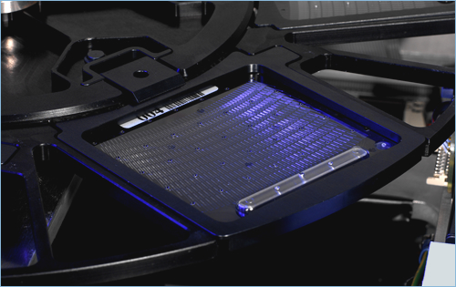
Microfluidic Liquid Handling
http://www.spinx-technologies.com/web/tech/tech03c.htm
Notes:
More exotic microfluic solutions are also available. In this one, you employ these plastic consumables with many reservoirs on the top. You place your samples for the experiment into these reservoirs. Below them is a network of small mixing chambers that are sealed off from one another by septa. The septa can be ablated by the instrument with a laser to open the flow of liquid from one to the next.
Operationally, you program the series of mixing events for your assay by telling the instrument which septa to ablate.
<click>
Many of these cassettes are stacked into a rack
<click>
and then loaded into the instrument
<click>
The samples are then placed in a centrifuge that forces the liquid from the reservoirs into the mixing chambers. Finally, the results of the assay are read out colorimetrically or fluorimetrically by looking at the ‘final’ mixing chambers with a microscope.

Slide 14
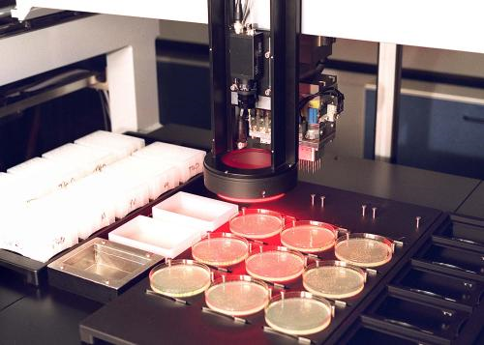
Colony Picking
Notes:
For directed evolution and combinatorial experiments based on screens, there is usually a step in the procedure in which you must pick many colonies of a library and inoculate small cultures in 384-well plates. For up to a few thousand colonies, this is most easily done by hand, but if you have more than 10,000 colonies to pick, you might want a colony picker. Traditional colony pickers employed 1-foot square petri dishes. You would fill these plates with agar at a precise volume to control for the height of the liquid and then plate your library to get nice, well-isolated colonies. Often you must play with this plating procedure to get the density right, but once you do, the colony picking goes very quickly. The instrument takes a picture of the plate and then uses image analysis to identify the positions of the colonies. It then very quickly passes a picking head over the plate and extends a needle at each colony to pick up some cells. Once it has done this for each pin of the head, it moves the head to a plate containing fresh media and sirs the pins within that liquid. It then sterilizes the pins with ethanol and heat and then repeats the picking process. Though a colony picker can take a long time to setup, once you have it working it picks colonies exceptionally quickly. A 20,000 colony pick will probably take an hour.
More recent instruments of this type (as shown here) work on conventional agar plates and employ more sophisticated algorithms to pick the colonies.

Slide 15
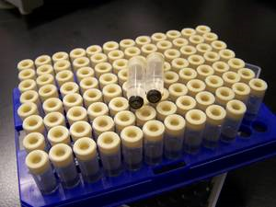
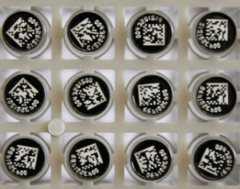
2D Barcoding
Notes:
The large number of samples that are implicitly involved in lab automation requires the use of barcoding techniques. When working with 96, 384, or 1536-well plates, it is common to use 1D barcodes in the form of stickers on the side of the plate. When you order oligos from IDT in a plate, you’ll notice that these barcodes are already present allowing tracking. You can also buy plates already fitted with a unique barcode in this fashion.
Another type of barcoding, shown here, involves special tubes with 2D barcodes on the bottom of each tube. These tubes snap into 96 or 384 well plates for storage. This labeling method allows you to segregate and track individual samples of a plate. In highly-automated companies like Ginkgo or Amyris, they track there samples this way. Even in the small academic wetlab, this barcoding technology is useful for maintaining -80 stocks of cell strains. The cost of these tubes is comparable to other screw-cap tubes, and the reader for the barcodes costs around $2K. We use this in my lab for this purpose, and it is helpful in dealing with the problem of determining what is in a sample long after the experiment is completed without the need for hand labeling.

Slide 16
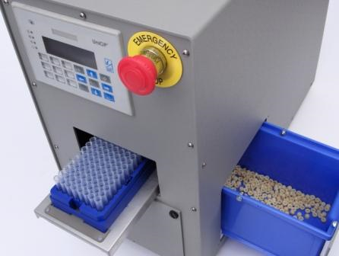
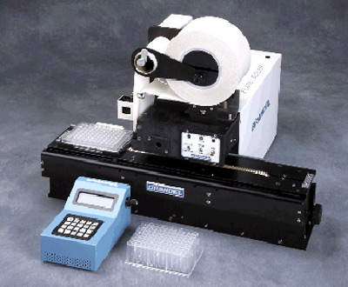
Plate Sealing / Desealing
Notes:
When working with large volumes of samples and many plates, even trivial operations like removing the caps from tubes can become rate limiting. Here I show an instrument that removes the little rubber caps from all the samples of a 96-well plate full of 2D-barcoded tubes. Other instruments can put the caps back on.
<click>
For more conventional plates that do not require single-well access, you can seal and deseal the plates using tape. Here a roller of tape is positioned next to the plate and is rolled over the plate to seal it.

Slide 17
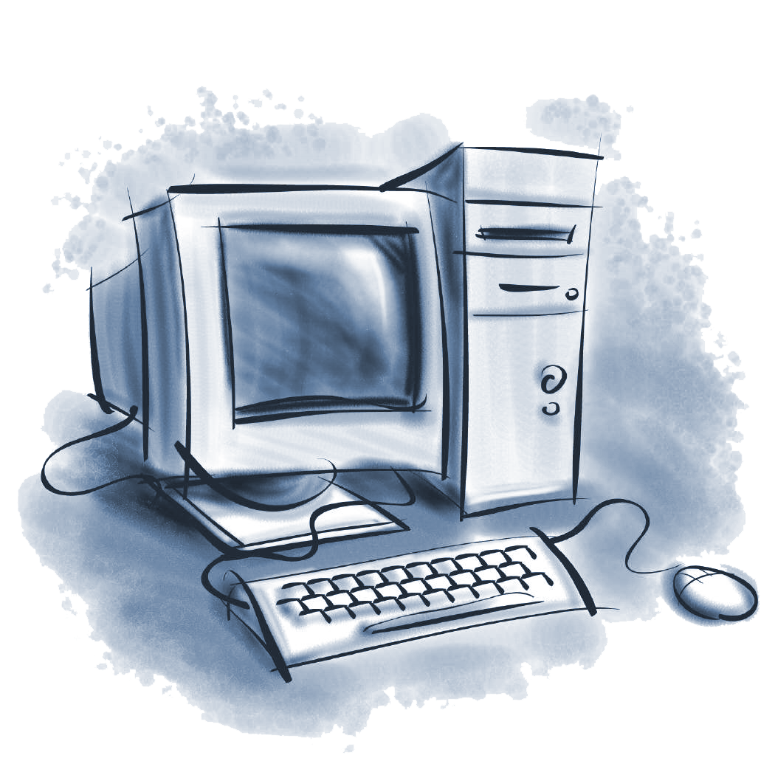
Software Tools
Notes:
Ultimately, robots are just a bunch of metal and motors. Software must orchestrate the processes involved in conducting an experiment. Some of this software will be encoded in the instrument’s firmware, and other times you control the instrument with an attached computer running software within normal operating systems, usually Windows-based.
However, the automation of experiments is not limited to operating robots, so let’s take a look at the other types of software used for automating synthetic biology.

Slide 18
Key areas for development
Standards
Data Structures (SBOL, BioBricks), Performance and measurement (PoPS)
Automated Design
Specification, design synthesis, verification
Automation/Manufacturing
Liquid handling robots, assembly algorithms
Tool Classification
Technical design tools
Data Management
Automated Compositional Design
Automated Assembly
Simulation
Notes:
Most software associated with synthetic biology is associated with standards development, automated design, or computer-aided manufacturing.
If I tell you “go build a part out of GFP” you pretty much understand what I mean, but you must inject a great deal of knowledge and make many microdecisions in order to implement the experiment. For example, should you make a biobrick part or a golden gate part, or can you do anything you want? Which GFP? What codon usage should I make that GFP out of? In what form do you want it – just an ApE file or do you mean a PCR product or a clonal DNA sample? There is a lot of subtlty to these terms that usually is ignored when we speak about things like parts and genes. When you right software, the computer only understands what you teach it, which requires that you very carefully define these concepts in code. This is the essence of standardization as it applies to BioCAD tools.
The BioBricks idea is essentially to define a series of rules for the contents of sequence to simplify what a computer must be told in order to understand the usage of that DNA fragment. In Biobricks, these rules are statements about forbidden restriction sites and how to calculate a larger composite sequence from a list of constituent basic parts. The SBOL effort is a consortium of researches that is developing a series of these standardized concepts, primarily focused on the representation of annotated DNA sequences and graphical representations of these sequences.
Automated Design tools allow a user to consider all possible options for implementing a genetic device. If I told you to make a pathway for xanthophyll, you’d probably google ‘xanthophyll biosynthesis’ and find some pages talking about how it is made naturally. You might poke around and find some additional ways to make that chemical, but you never know for sure that you considered all options. If instead you provide all the raw data in a standardized form to the computer, you can use algorithms to search the space for all possible solutions. Such approaches have been used for anabolic and catabolic pathways, but they are also under development for genetic circuits.
Automated manufacturing, or CAM-based tools, employ standard assembly protocols like BioBricks to design a fabrication process. So, you input a specification of what DNAs you’d like to put together, and these software tools figure out how to piece that together most efficiently and cost-effectively. Some of these tools connect directly to liquid-handling robotics to fully black-box the details of DNA fabrication.
<click>
There are a variety of pre-existing tools adapted from fields such as Systems Biology that are useful for genetic engineering. I’ll break this space down into 4 categories: technical design tools, data management tools, automated design tools, and simulation.

Slide 19
Technical Design Tools
Notes:
Technical design tools deal with the problem of reducing a concrete specification of genetic composition to a method of fabrication. Essentially, this is the automation of the tasks you have learned how to do manually in the first half of this course.

Slide 20
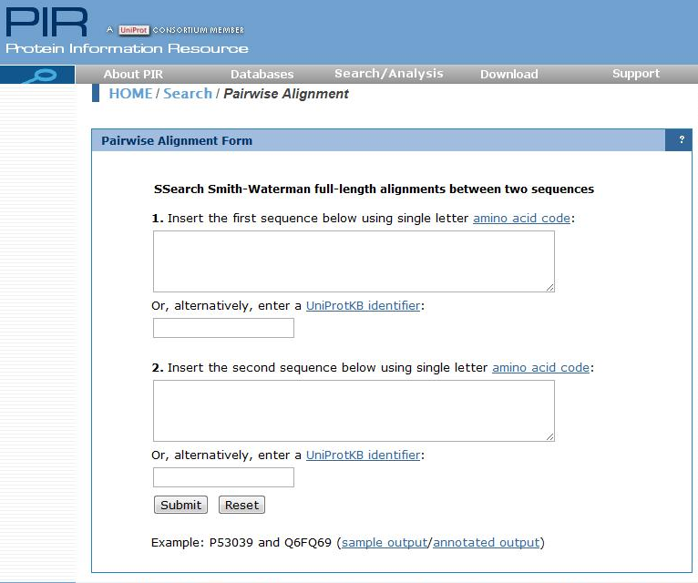
Notes:
You’ve already used some examples of automation tools for doing technical design. A pairwise alignment tool takes as input two sequences and performs the Smith-Waterman algorithm (or its variants) to identify regions of homology between the sequences. You can use this for analysis of sequencing data or the identification of homologous regions between sequences, or the alignment of oligos to a template sequence amongst many other uses.
A wide variety of sequence analysis webtools are available, and if you google what you want to do you’ll find them. These tools are more general molecular biology tools like mfold, clustalw, translation, and the like that are helpful for genetic engineering but are not specific to the domain – they are widely used in many subfields of biology.

Slide 21
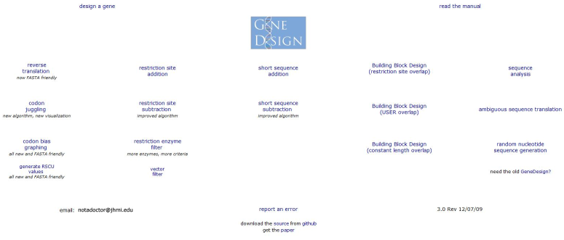
GeneDesign
Notes:
Genedesign is a powerful suite of automation tools developed by Sarah Richardson. It offers several different design algorithms. You used this tool in the tutorials to design the oligos for polymerase chain assembly, but it does other things. You can remove restriction sites by silent mutation, you can codon optimize a gene for expression in a host or other metrics, you can introduce silent mutations that introduce restriction sites (so, you can add a restriciton site without changing the protein sequence being encoded), and you can design standard assembly schemes based on several different chemistries.

Slide 22
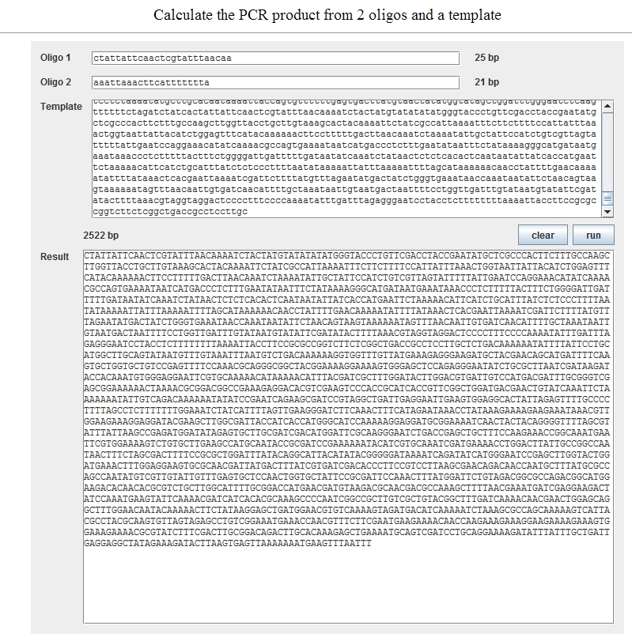
PCR Prediction
http://andersonlab.qb3.berkeley.edu/Software/PCRPredictor.html
Notes:
Several tools exist that can input two oligos and a template and output the expected PCR product. A popular mac-specific one called Amplify, but this only runs on powerPC macs. This is a web version that does the same thing.

Slide 23
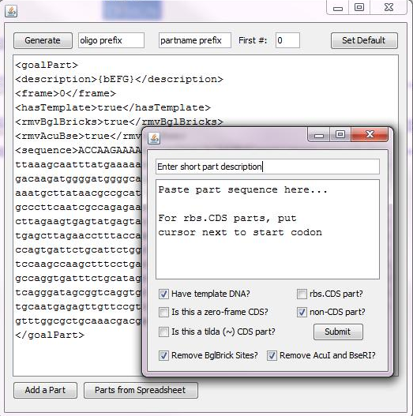
Oligo Designer
http://andersonlab.qb3.berkeley.edu/andersonSoftware.html
Notes:
A few tools exist that do soup-to-nuts design. OligoDesigner, shown here, allows you to paste in a series of part sequences, and it will automatically choose the best method for fabricating a BioBricks part using PCR, SOEing, or PCA. After it runs, it outputs lists of oligos and order forms for IDT. This tool is very specific to making BioBricks parts. Other tools exist specifically to make Golden Gate parts, and software is under development that allows you to specify different types of standardized parts on the fly.

Slide 24
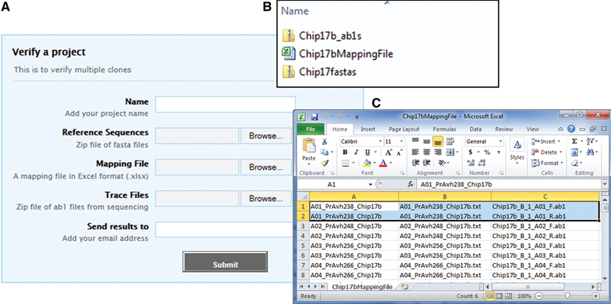
GenoREAD
Notes:
Jean Peccoud has developed the first publically-accessible webtool for analyzing sequencing data called GenoREAD. You pass it the sequencing data and the list of sequences you want to check against, and it does the rest of the analysis for you. In the end it provides a report of the analysis.

Slide 25
Data Management Platforms
Notes:
The large number of genetic designs that get employed during synthetic biology experiments often puts a burden on conventional record keeping. Once you hit your 500th part, that paper notebook just won’t cut it anymore as a means of tracking your sequences and stocks. Data Management platforms understand the data structures present in your work (such as your oligos, plasmids, or cell stocks), and store this data. Effectively, they are databases with user interfaces and a small amount of business logic.

Slide 26
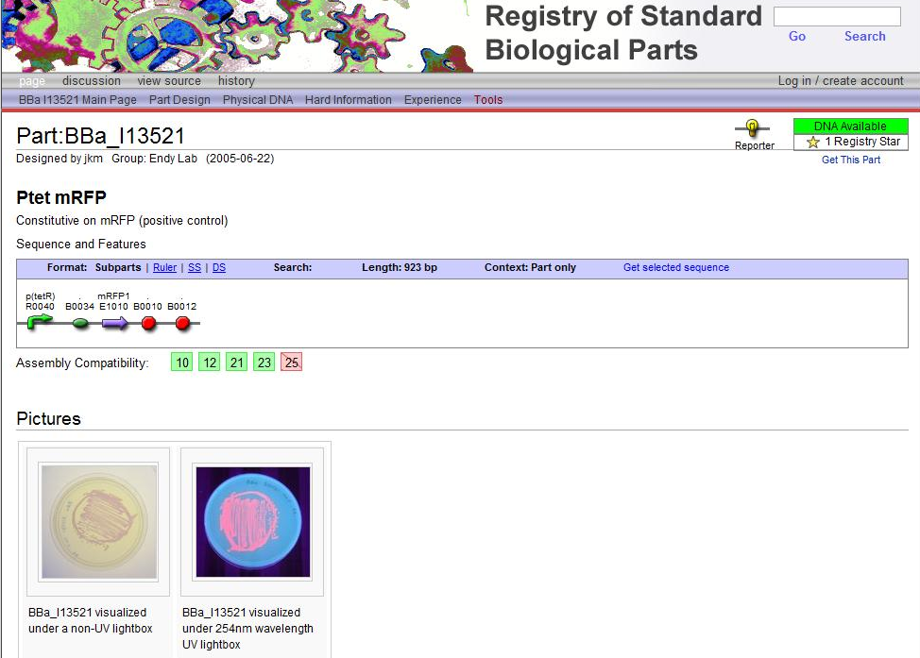
Notes:
The Registry of Standard Biological parts was started at MIT in 2003 based around Tom Knight’s idea of a BioBrick part. Each brick encodes a piece of information such as promoter, coding sequence, or terminator, and there was one standard method for assembling these parts (BioBrick standard assembly). Each part has an entry within this database presented to the user as the Registry of Standard Biological Parts website. A sample of plasmid DNA encoding the part is housed in a centralized repository and distributed. The Part data stored in the database can be used to specify composite parts as a list of smaller basic parts. This way, you can simply specify the composition of larger devices, and the software can generate graphical visualizations and the full-length sequence. The Registry also provides wiki functionality for users to describe the functionality, usability, or other explanations of the part.
Each year, this collection of samples is distributed to every institution that participates in the iGEM competition. In response, participants are expected to provide new samples to the Registry to grow the effort each year. All the part sequences are made public through the Registry. Today, the Registry is run by Randy Rettberg from a non-for-profit group that also runs the Registry. Thus, the two efforts are often regarded as one and the same. However, there are also Registry users outside of the iGEM program. The Registry is generally regarded as the first foray into the space of formalization and computerization of genetic engineering.

Slide 27
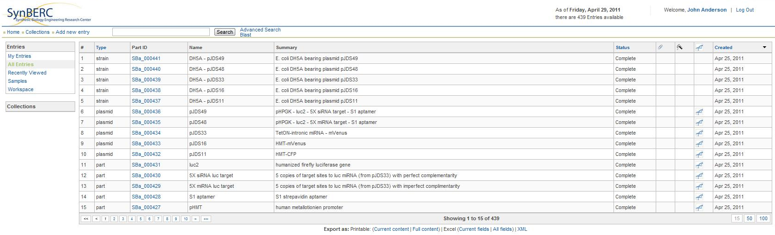
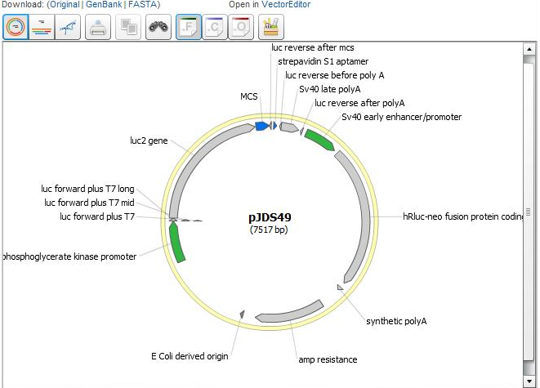
JBEI-ICE
Notes:
The Registry was innovative and has been highly successful amongst younger engineers. However, the culture of the field today prevents development of expensive and slow research in a fully open setting. The cost of high-value genetic information is too high right now for biotechnologists to operate without full control of their data servers and security over the access to their intellectual property. Users also wanted more functionality and more compatibility with non-BioBrick work.
JBEI-ICE, also referred to as JBEI Registry or just ICE was developed by Tim Ham at the Joint Bioenergy Institute (which is the biofuel effort run by Jay Keasling). Instead of just one centralized database, ICE is open source such that many distinct databases can be set up. Primarily one uses ICE to store, visualize, and share annotated sequence information. However, it also provides tools for automating the analysis of sequencing data and hooks into several design tools. ICE is the first BioCAD tool with the ‘web-of-registries’ concept in which a network of registries speak to one another sharing genetic information.

Slide 28
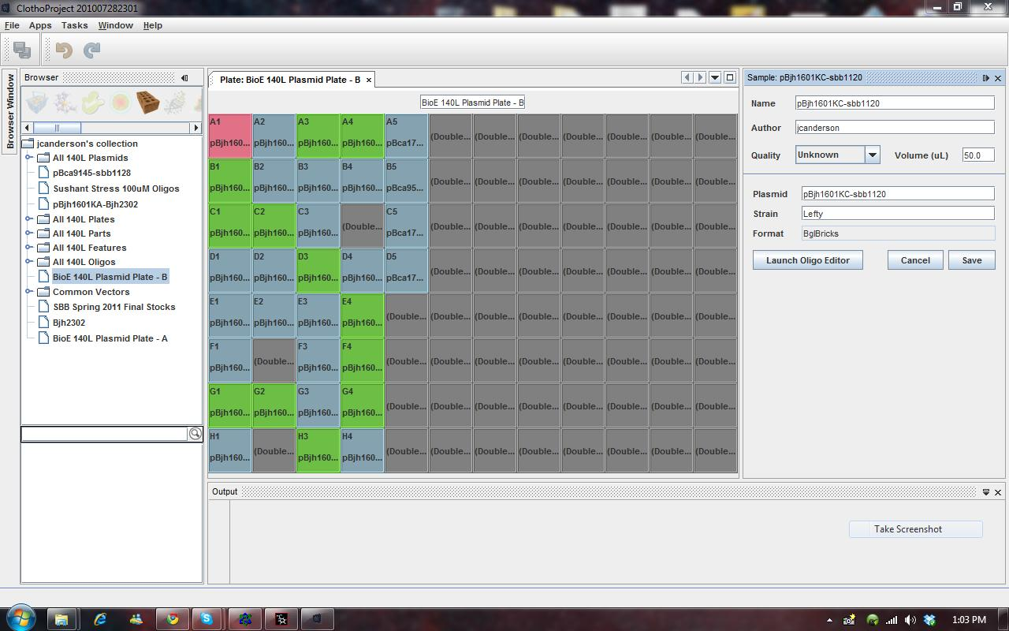
Clotho
Notes:
Clotho is an effort to connect together BioCAD tools into a coherent ecosystem. It houses sharable apps that perform distinct types of work on data objects such as samples, plates, and the like. Clotho was started by Douglas Densmore and myself starting in the iGEM program for the first few years. Shown here is a plate editing tool from the Clotho 2.0 distribution in 2010. The 3.0 version of Clotho will be released in 2014 and will be the first enterprise-quality version of the tool. It features dynamic schemas to represent a broader array of data concepts and web interfaces. Primarily Clotho is intended as the glue to deal with the fact that software tools in genetic engineering typically are unable to interact with one another. It can handle tools written in different languages on slightly different data structures, and other such integration issues.

Slide 29
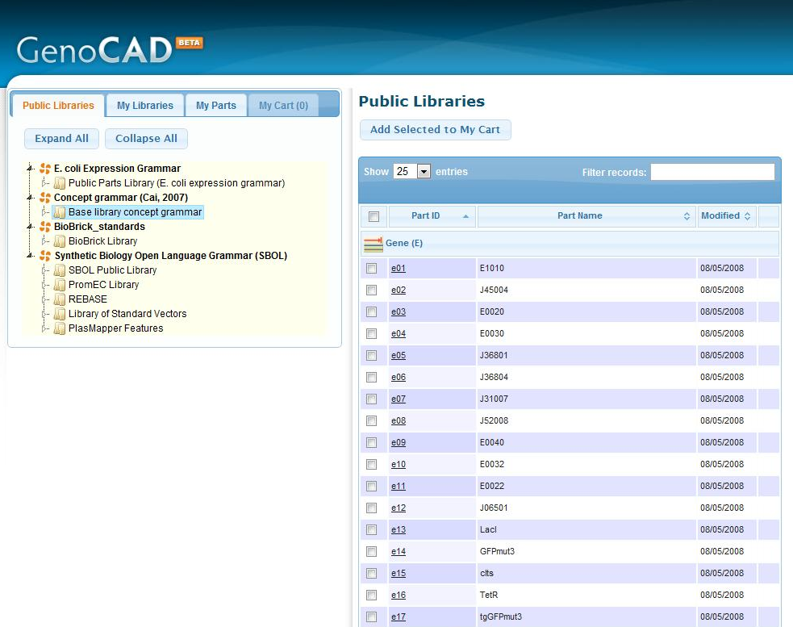
Notes:
GenoCAD is a mixture of computer aided *design* (like, it helps you design your constructs) and data management. It was developed by Jean Peccoud, and it is deeply rooted in the notion of standardized parts and part grammers. All Parts belong to one ‘part of speech’ according to the central dogma. Because it wouldn’t make sense, for example, to place a promoter downstream of its gene, this type of constraint on composition can be used to direct a user to designs that can work. It also enables an innovative interface in which you use a pull down menu to choose the parts that might be appropriate for a given position in the design. These designs can be saved to your account on a centralized server.

Slide 30
Automated Compositional design

Slide 31
Levels of part/feature specification
AraC
Pbad
Part I0500 (contains 2 explicit Features)
Grammatical: “The part initiates transcription”
Biochemical: “The promoter is bound by AraC”
Kinetic: “The Kd for AraC bound to the promoter is 50nM”
Familial: “The part is a member of the inducible promoter family”
Phenomenalogical: “Don’t use Pbad to drive part E0043”
Notes:
Compositional design is the topic of what we make our devices out of. It’s the process by which you choose the parts that will make up your system. Because such tools must make choices about which parts to use or not use, such tools must operate with a currency of information about parts. There are 5 different types of information that are usually encoded by a software
Grammatical information says something about the part’s role in the central dogma. For example, “This promoter part initiates transcription”
Biochemical information says something about the molecular details of the interactions encoded by the part. For example, “The promoter is bound by AraC”
In some tools, more granular knowledge of the energetics (and thus kinetics) of the biochemical interactions must be captured. For example, “The Kd for AraC bound to the promoter is 50nM”
Other systems allow users to define families of related parts such as a useful set of promoters or mutants of a gene. For example, “The part is a member of the inducible promoter family”
Finally, some tools allow you to define phenomenalogical or experiential rules about how a part should be composed with other parts. For example, “Don’t use Pbad to drive part E0043, it’s lethal”
The organization of information in the context of computer science is referred to as an ‘ontology’. Thus, there are part ontologies that form the basis for many tools based upon these different ideas of what is the relevant piece of information for computation.

Slide 32
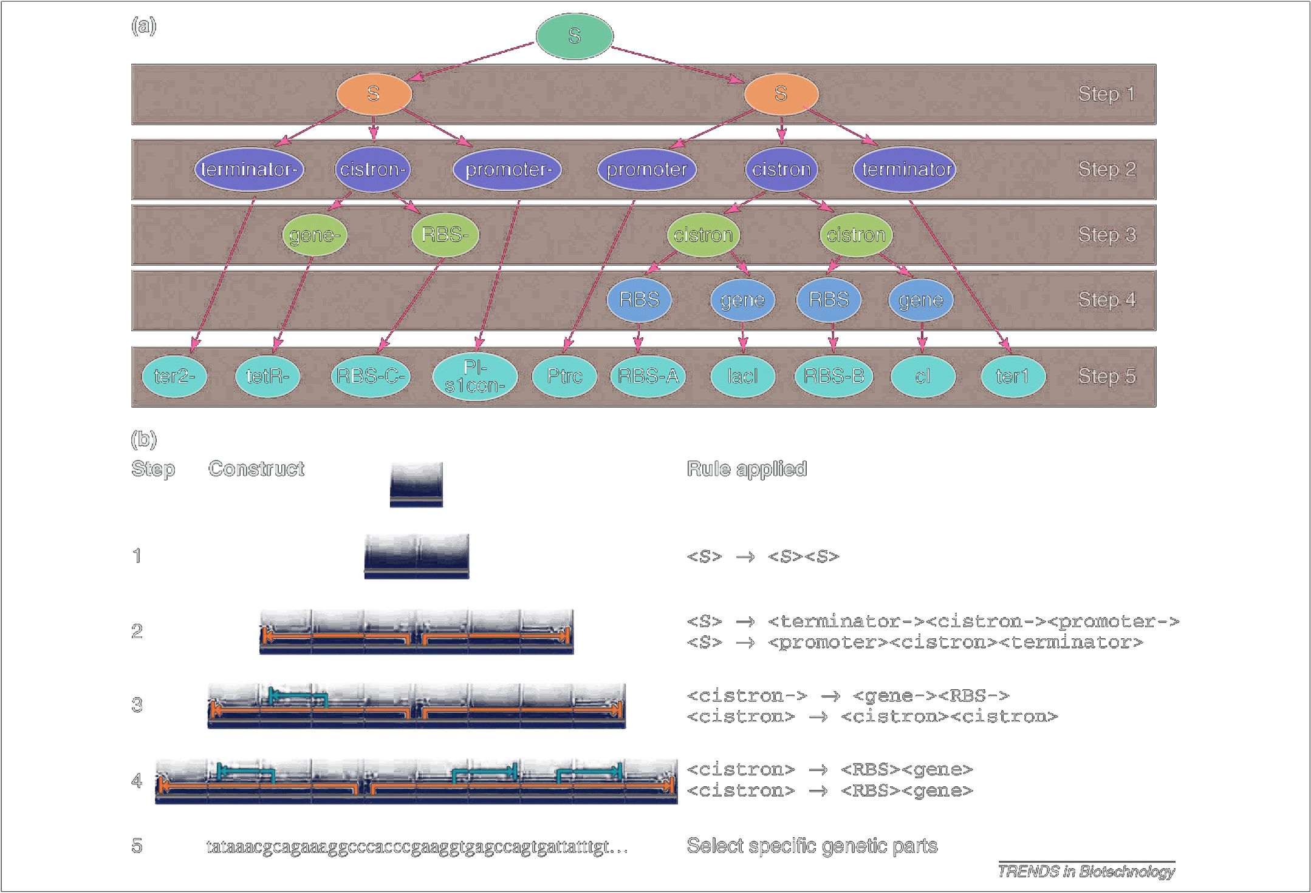
Genocad and Grammer
Trends Biotechnol. 2008 Oct;26(10):538-44. PMID: 18687496
Bioinformatics. 2007 Oct 15;23(20):2760-7. PMID: 17804435
Notes:
We’ve already talked about GenoCAD briefly. It uses grammatical types like promoter, coding sequence, or terminator to organize its parts. When you design a construct in GenoCAD, you first design at the level of abstract compositions in which each position of your part could be any of a list of promoter, or any of the list of terminator. You then can concretize each position of the device by using a pulldown menu and selecting the one you want.

Slide 33
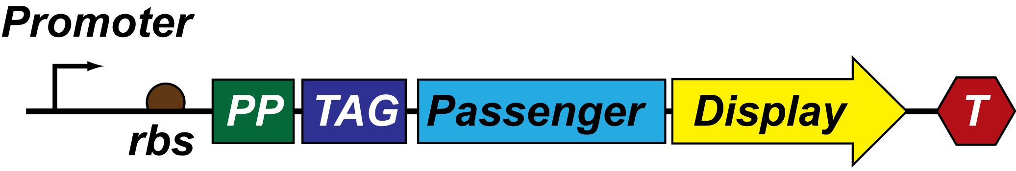
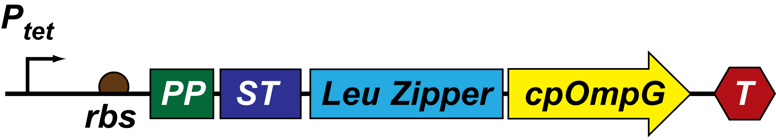
Eugene
Pbad
Ptet
PmgrB
Lux Operon
Repressilator
Sec
Tat
FLAG
Myc
HA
Strep
Beta Helix
MagBead_BP
Chal
Aluminum BP
INP repeats
AG4
Beta Roll
KILR
TraT
upaG_short
Ag43_short
Ag43_long
CpOmpG
espP(beta)
TshA
eCPX
ehaB
TCCCTATCAGTGATAGAGATTGACATCCCTATCAGTGATAGAGATACTGAGCAC
ATGGCTTCGGCAAGTGCGTCGAGC
M10086 {<CPG_L2!}
M10011 {<CPG_L6!}
Notes:
Eugene encodes user defined families of parts and user-defined phenomenalogical rules of composition. It was developed by Douglas Densmore. In the example here, we illustrate two abstract compositions made of families of parts such as ‘passenger’ or ‘PP’. These user-defined families are each a set of concrete part sequences.

Slide 34
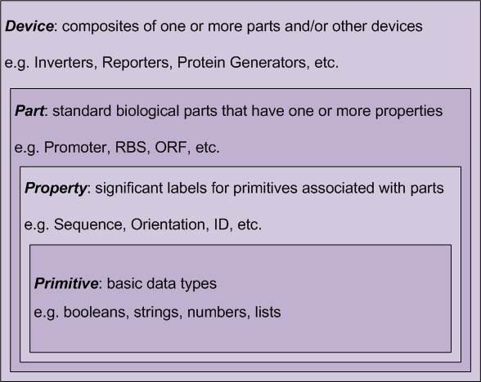
Eugene Scripts: composition
PMID: 21559524
Notes:
You encode a Eugene Script by defining Devices in terms of Families which are made of Parts that have Properties that are expressed as Primitive data types. In this way, you hierarchically describe the space of a composition and the properties of the potential constituents of the space.

Slide 35
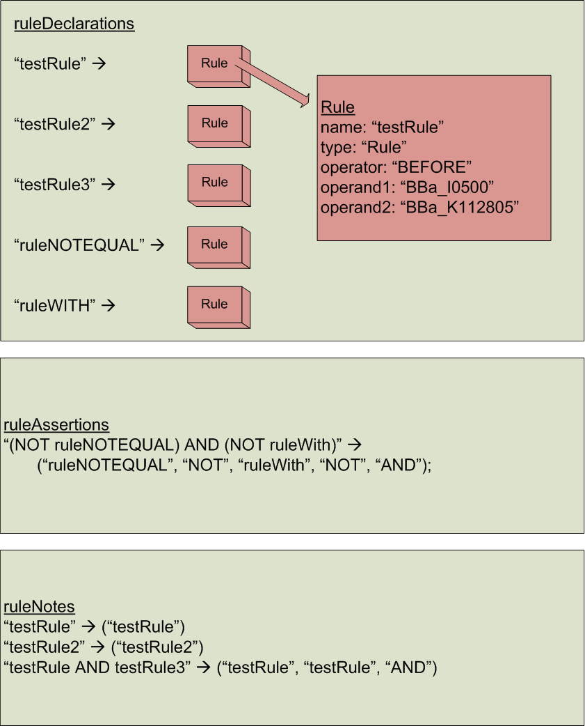
Eugene Scripts: rules
Notes:
The script also encodes rules about which parts can be combined with other rules. For example, it is experientially known that when you encode a P450 oxidase in the cell, you need to provide a reductase from the same organism, or they will not interact. You can express the source organism as a property when describing the device, and you include this rule of source organism as shown here.

Slide 36

Eugene Scripts: execution
Generate all “Devices” that obey the list of rules
Notes:
Once you have written a script, you can execute it. It will permute all members of the abstract device and output a list of concrete compositions that all satisfy the supplied rules.

Slide 37

Retrobiosynthesis Tools
Notes:
Tools that attempt to design metabolic pathways from biochemical ontologies have been under development for many years. Here we show the sort of output these tools can generate. This is all the paths that Act synthesizer finds for making p-aminophenol.
Act Synthesizer was developed by a Berkeley team including myself, which we have used in this course. Act is a more recent upstart in this category. Other major efforts in this area are Vassily Hatzimanikatis’ program BNICE and PathPHRED. All are based on tracing paths through data encoding enzymatic information such as “butanol is oxidized to butanal by felZ oxidoreducase” either directly or indirectly. The most commonly-used tricks are a breadth-first search algorithm to trace paths to a target through the hypergraph of reactions, or to employ reaction operators that capture the pattern of atoms present in these reactions. It turns out to be a quite meaty and complicated task to design biosythetic pathways, hence the many efforts to solve it. It is challenging both in terms of how we represent biochemical information and the computational challenge of searching through large hypergraphs.

Slide 38

Toolchain Integration
Notes:
All the tools I’ve shown here fit in the general realm of compositional design. They deal with the question of how you go from a specification of behavior to a specific part composition with a specific DNA sequence. The tools I’ve described each have a different niche within the design flow and will likely ultimately be combined into singular coherent tool chains. The first attempt at unification was the TASBE effort in which a high level specification language called Proto, developed by Jake Beal, could be reduced to an abstract genetic regulatory network, which in turn could be concretized with distinct parts, then assembled in combinations by automated assembly. In this context, the retrobiosynthesis tools are comparable to the high-level role of proto, but for a different use case and a very different mechanism. It has become clear that at this very high level of design different synthetic biology devices (biosynthetic, cell surface modication, and biosynthesis) the software challenges of synthetic biology are best solved in domain-specific ways. However, below this level at the part specification level, the software all likely collapses into a singular work flow.

Slide 39
Automated Assembly
Notes:
In the example of the TASBE effort, the process of genetic design and wetlab implementation spans the full range of biocad problems from specification to manufacture. The last step in that tool chain is automated fabrication. It is generally assumed that fabrication will always follow a three step process in which DNAs are first fabricated in the form of shorter fragments from individual bases, most likely oligos, then assembled into synthons or parts, and from here to device-length DNAs. The lab automation of the first two steps of this process is well established in industry as commercial products, and most research on these topics is proprietary. In contrast, the larger scale synthesis of DNAs on the multi-part scale (5kb-40kb) is primarily done in academia still. Thus, more is known about it.

Slide 40





Automated Physical Assembly
Clotho Plate Manager
Clotho Algorithm Manager
Notes:
This graphic is from the Clotho-related automated assembly effort for biobrick standard assembly using liquid handling robotics. In general, such software begins with a list of goal parts – the specific compositions of parts you want to put together.
<click>
You also provide the data for where in plates the samples of the parts are held.
<click>
An interface allows you to edit the goal parts and design an assembly strategy that is most efficient for this set
<click>
And finally it reduces the series of manipulations to liquid handling commands that are sent to a robot.

Slide 41
Abstraction and Automated Assembly
(Show J5 video)
http://jbei-exwebapp.lbl.gov/j5/j5_and_DeviceEditor_Demo_Movie.mov
Notes:
J5 is a tool developed at JBEI by Nathan Hillson that enables you to specify goal parts and choose the best method of standardized assembly. The most powerful aspect of the tool is the encoding of decision logic about the price of fabrication for a given method as well as the design of the assembly scheme. Let’s watch the video.

Slide 42
Kinetic Models and simulation
Notes:
Many of the early ideas in BioCAD at the start of synthetic biology grew out of Systems Biology with a heavy emphasis on simulation. These types of tools were central to both fields. In many ways, synthetic biology has become its own clade of forward design tools that only partially overlaps the systems biology tools around biochemical ontologies and these simulation tools.

Slide 43
Kinetic / Stochastic Models
Define the cellular concentrations of various biomolecules as variables
Write equations (differential equations or stochastic models) describing how these concentrations influence one another
Compute how these concentration variables change over time
Can use these models to analyze different circuit architectures and decide better ones to build
Notes:
The basic idea of a simulation is define an initial concetnration of each molecule type in the cell as a variable. You then write out equations that describe how these concentrations will change as a functional time as a function of the concentrations of the other chemicals. You then simulate what the system will do either by numerical solutions to differential equations or a stochastic simulation.
Often computational biologists use these simulations to model the behavior of complex biological systems. In the context of synthetic biology, these tools allow the engineer to model different circuit architectures to decide which ones might be better than others.

Slide 44

A Kinetic Model:
The Pulse Generator
Proc Natl Acad Sci U S A. 2004 Apr 27;101(17):6355-60. PMID: 15096621
Notes:
Here’s an example of a model from Ron Weiss. Shown is a cartoon of the process they wish to model. The pulse generator cells encode a consitutively-expressed luxR gene which produces the luxR protein. If LuxR binds to exogenously provided homoserine lacton, it will activate LuxI promoters. Activation of these promoters leads to the production of GFP and CI protein. Once CI accumulates, it will shut down production of GFP resulting in a temporal pulse of GFP expression.

Slide 45

A Kinetic Model:
The Pulse Generator
Total: 44 of these and 23 species
Example system of Diff Eq (don't take it literally, one equation for each of the 23 species):
d[RNAp]/dt = kassoc(cI2)*[mRNAluxR] - kdec(mrna_luxr)*[RNAp]
Put specific parameters in for each constant and initial values for each species concentration, then run the computer
Proc Natl Acad Sci U S A. 2004 Apr 27;101(17):6355-60. PMID: 15096621
Notes:
Computationally, they describe this system in terms of 23 species doing 44 reactions. Here we show just 3 of the reactions. Each term describes the concentration of a different chemical species in the system. For example, these reactions all describe transcriptional, translational, or decay processes. Similar models can be written for enzymatic transformations. You can then translate the system of chemical equations into a series of differential equations.
<click>
Here we describe how the concentration of RNAp changes as a function of time in a manner related to the concentration of an mRNA and its decay.
<click>
You can then adjust the paramaters in these models which encode information such as the translation or transcription rate. By examining how the model changes in response to these adjusted parameters, you can examine the scope of behaviors that this particular gene regulatory network is likely to exhibit.

Slide 46

A Kinetic Model:
The Pulse Generator
Proc Natl Acad Sci U S A. 2004 Apr 27;101(17):6355-60. PMID: 15096621
Notes:
In this case, they are able to fairly precisely describe the observed pulse behavior for the circuit they built in the wetlab.

Slide 47

Tinkercell
Notes:
Often stochastic and differential equation based modeling is done in Matlab or in gui-less C programs. However, there are also specific tools for modeling and illustrating the results of biochemical network simulations. Many such tools exist within the domain of systems biology, and a few carry over to synthetic biology. Tinkercell developed by Herbert Sauro and Deepak Chandran provides a user interface for drawing genetic circuits in the same way that lab researchers typically draw them on paper. The software translates this architecture into an SBML model, which can be translated into a differential equation or stochastic model, and then simulated.

